Slide 1

Chapter 15
Transmission
Control
Protocol (TCP)
Copyright © The McGraw-Hill Companies, Inc. Permission required for reproduction or display.

Slide 2
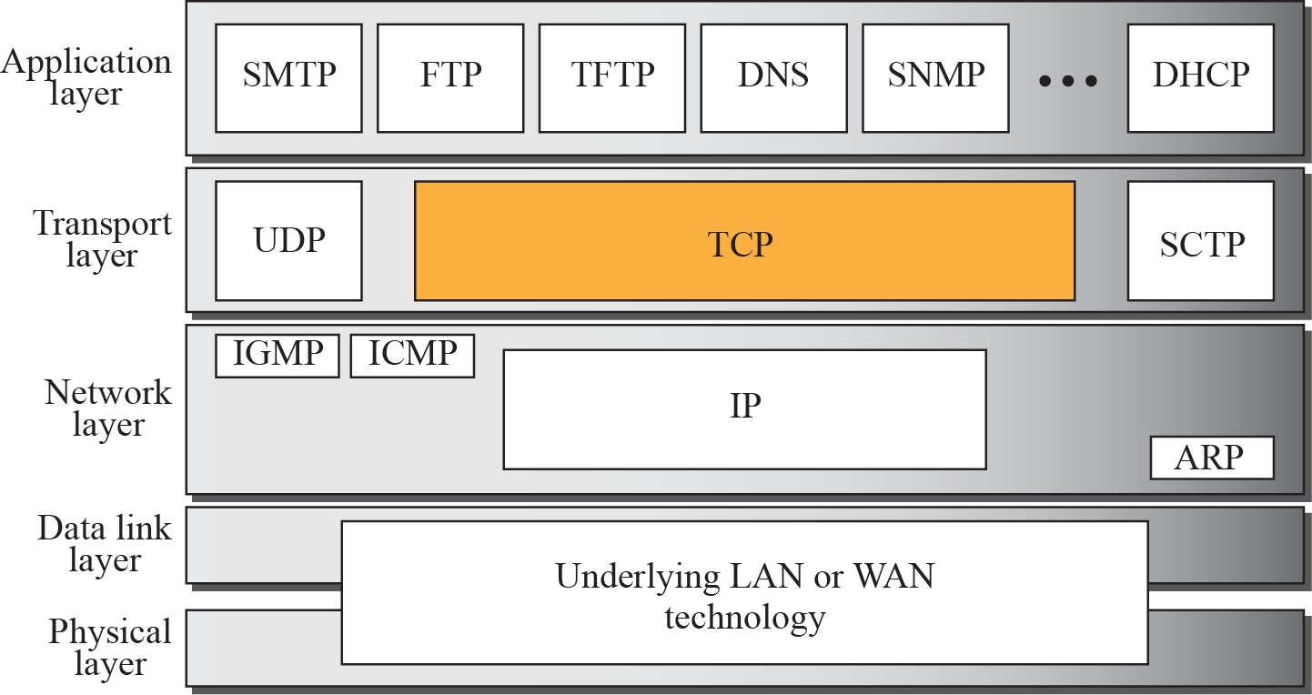
Figure 15.1 TCP/IP protocol suite

Slide 4
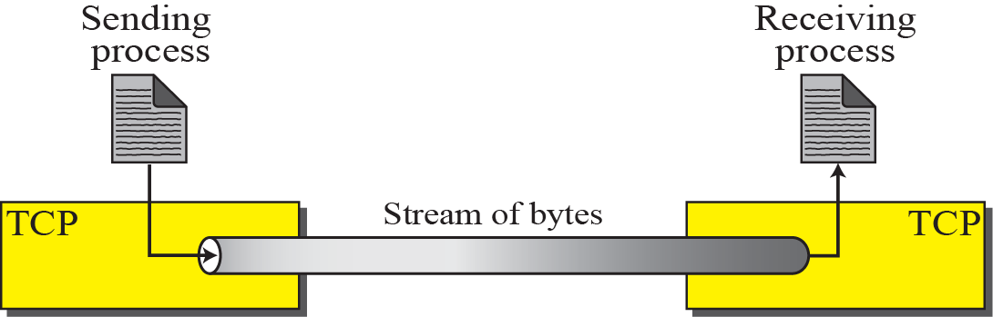
Figure 15.2 Stream delivery

Slide 5
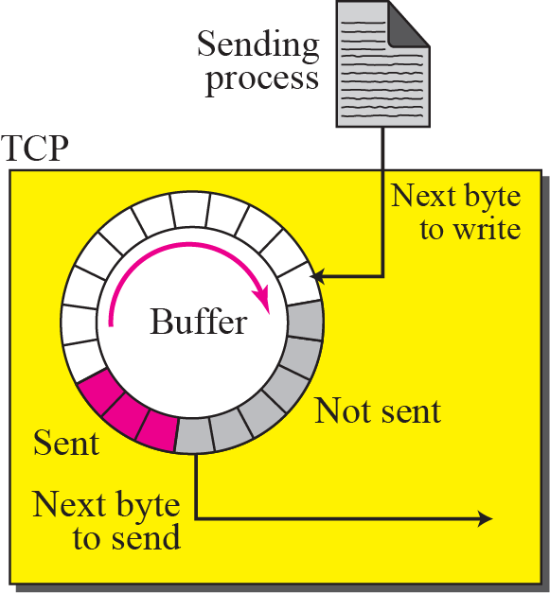
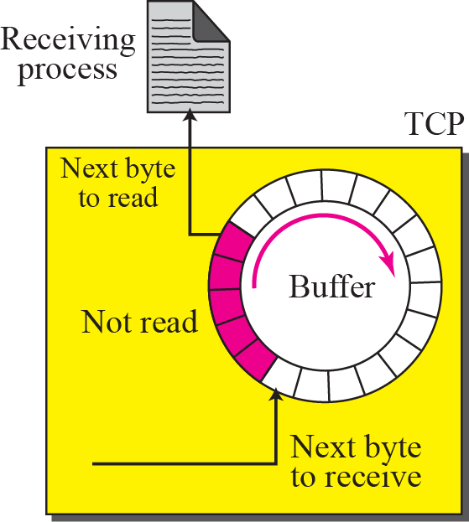
Figure 15.3 Sending and receiving buffers

Slide 6
Figure 15.4 TCP segments

Slide 7

Note
The bytes of data being transferred in each connection are numbered by TCP.
The numbering starts with an arbitrarily generated number.

Slide 8
Note
The value in the sequence number field of a segment defines the number assigned to the first data byte contained in that segment.

Slide 9
Note
The value of the acknowledgment field in a segment defines the number of the next byte a party expects to receive.
The acknowledgment number is cumulative.

Slide 10
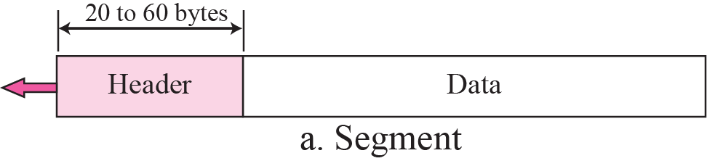
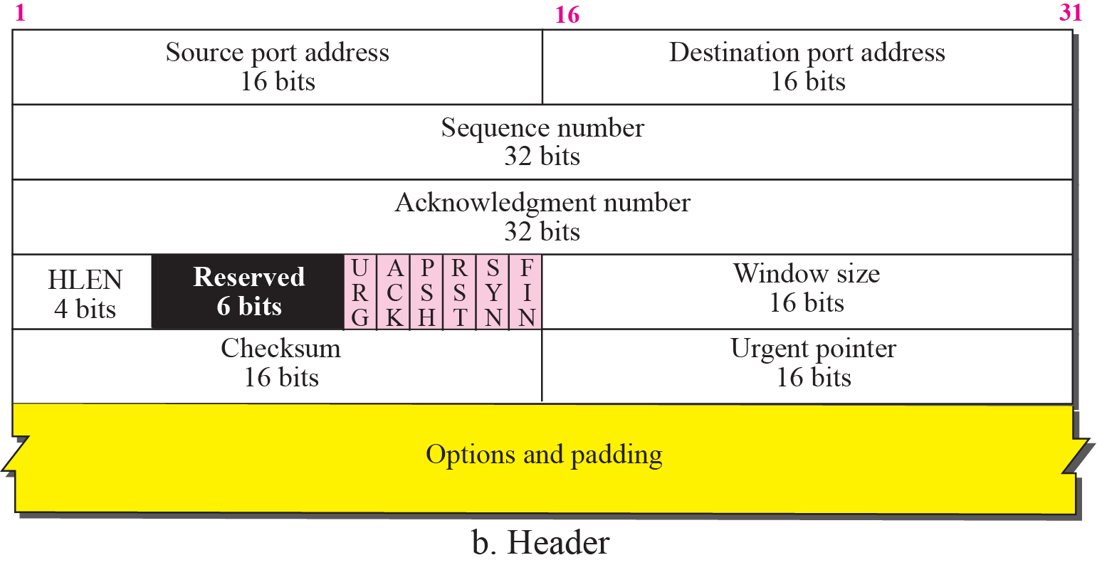
Figure 15.5 TCP segment format

Slide 11
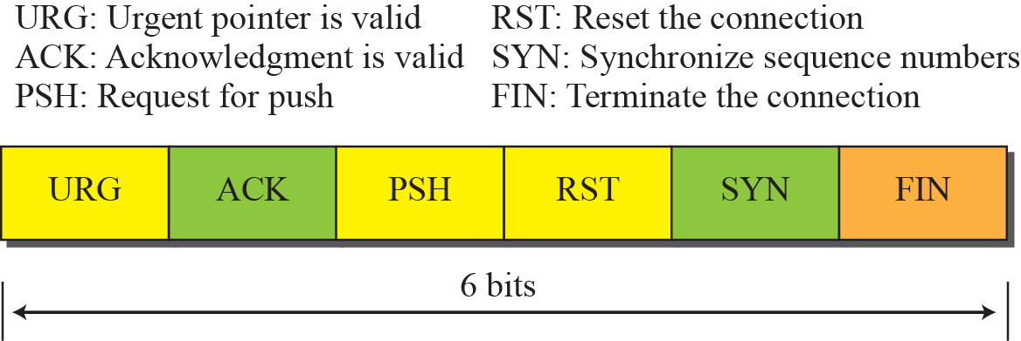
Figure 15.6 Control field

Slide 12
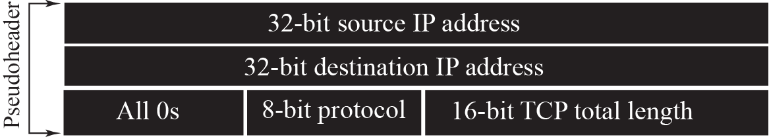
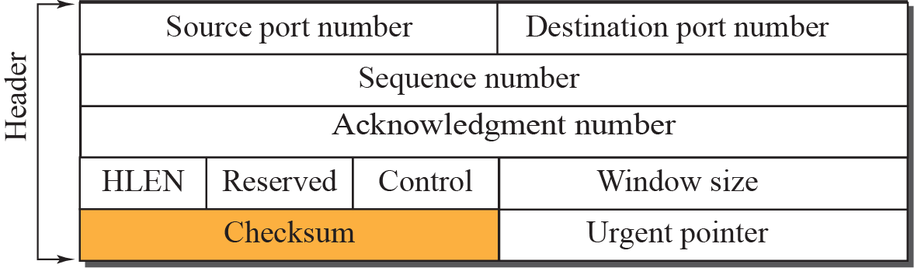

Figure 15.7 Pseudoheader added to the TCP segment

Slide 13
Note
The use of the checksum in TCP is mandatory.

Slide 14
Figure 15.8 Encapsulation

Slide 15
15-4 A TCP CONNECTION
TCP is connection-oriented. It establishes a virtual path between the source and destination. All of the segments belonging to a message are then sent over this virtual path. You may wonder how TCP, which uses the services of IP, a connectionless protocol, can be connection-oriented. The point is that a TCP connection is virtual, not physical. TCP operates at a higher level. TCP uses the services of IP to deliver individual segments to the receiver, but it controls the connection itself. If a segment is lost or corrupted, it is retransmitted.

Slide 16
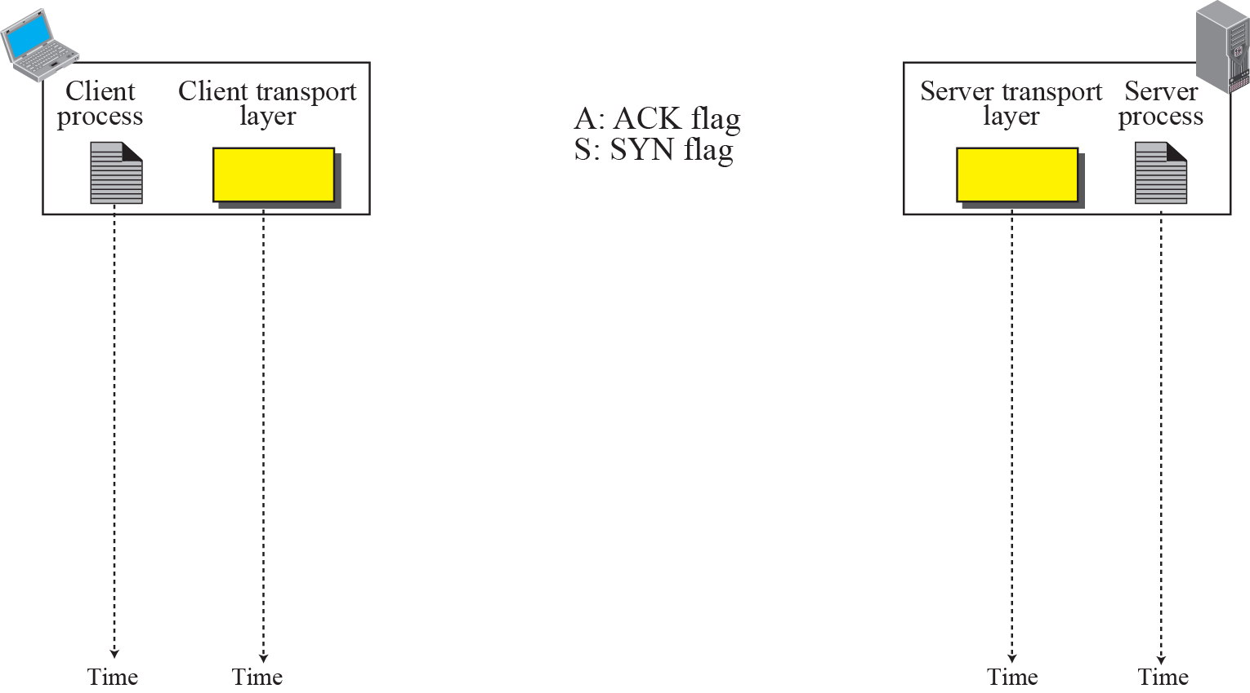

Figure 15.9 Connection establishment using three-way handshake
Means “no data” !
seq: 8001 if piggybacking

Slide 17
Note
A SYN segment cannot carry data, but it consumes one sequence number.

Slide 18
Note
A SYN + ACK segment cannot carry data, but does consume one sequence number.

Slide 19
Note
An ACK segment, if carrying no data, consumes no sequence number.

Slide 20
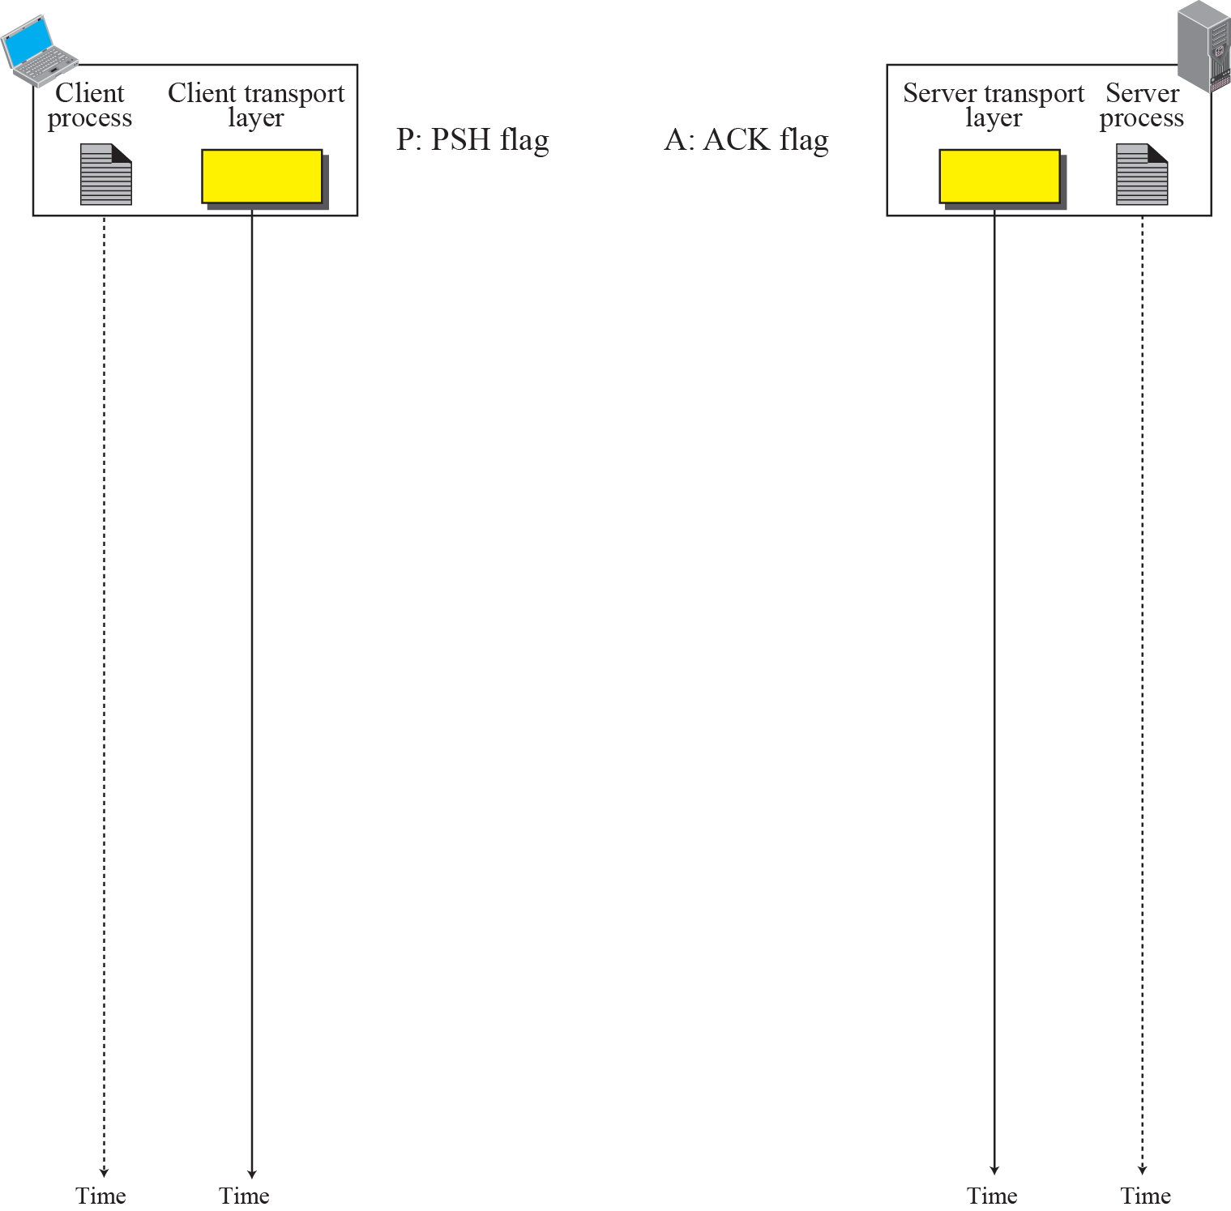
Figure 15.10 Data Transfer
Pushing data
Urgent data

Slide 21
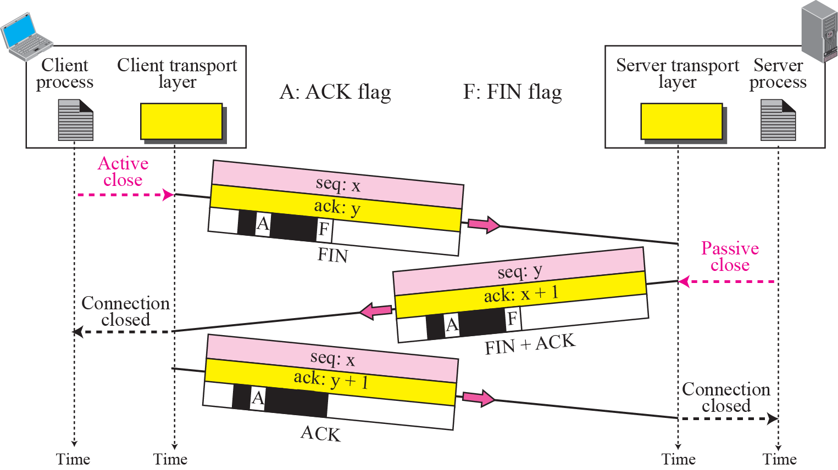
Figure 15.11 Connection termination using three-way handshake

Slide 22
Note
The FIN segment consumes one sequence number if it does not carry data.

Slide 23
Note
The FIN + ACK segment consumes one sequence number if it does not carry data.

Slide 24
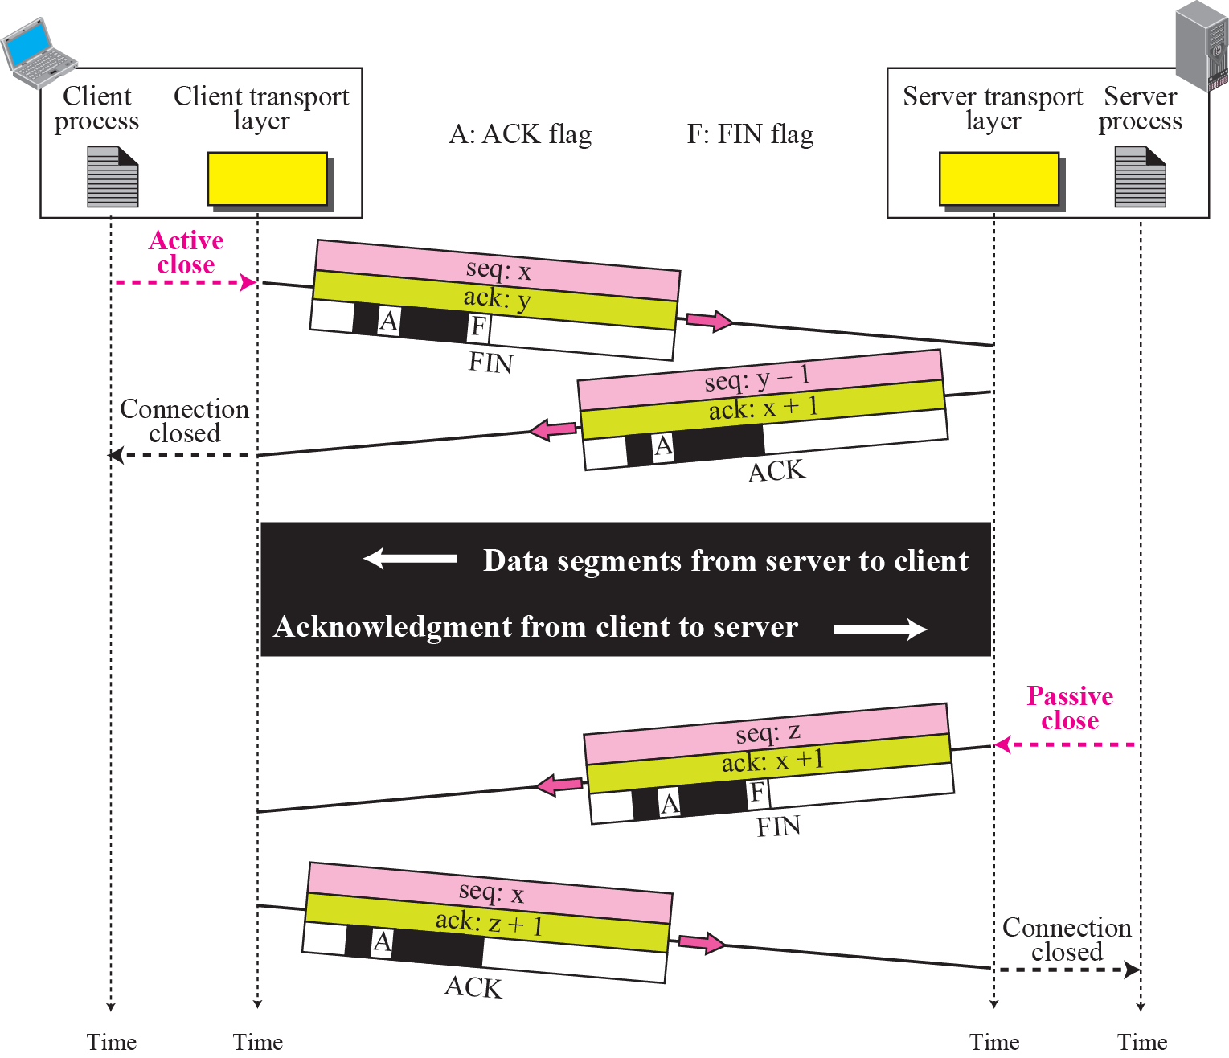
Figure 15.12 Half-Close

Slide 25
15-5 STATE TRANSITION DIAGRAM
To keep track of all the different events happening during connection establishment, connection termination, and data transfer, TCP is specified as the finite state machine shown in Figure 15.13.

Slide 26
States of TCP
State | Description
CLOSED | There is no connection
LISTEN | The server is waiting for calls from the client
SYN-SENT | A connection request is sent; waiting for acknowledgement
SYN-RECEIVED | A connection request is received
ESTABLISHED | Connection is established
FIN-WAIT-1 | The application has requested the closing of the connection
FIN-WAIT-2 | The other side has accepted the closing of the connection
CLOSING | Both sides have decided to close simultaneously
TIME-WAIT | Waiting for retransmitted segments to die
CLOSE-WAIT | The server is waiting for the application to close
LAST-ACK | The server is waiting for the last acknowledgement

Slide 27
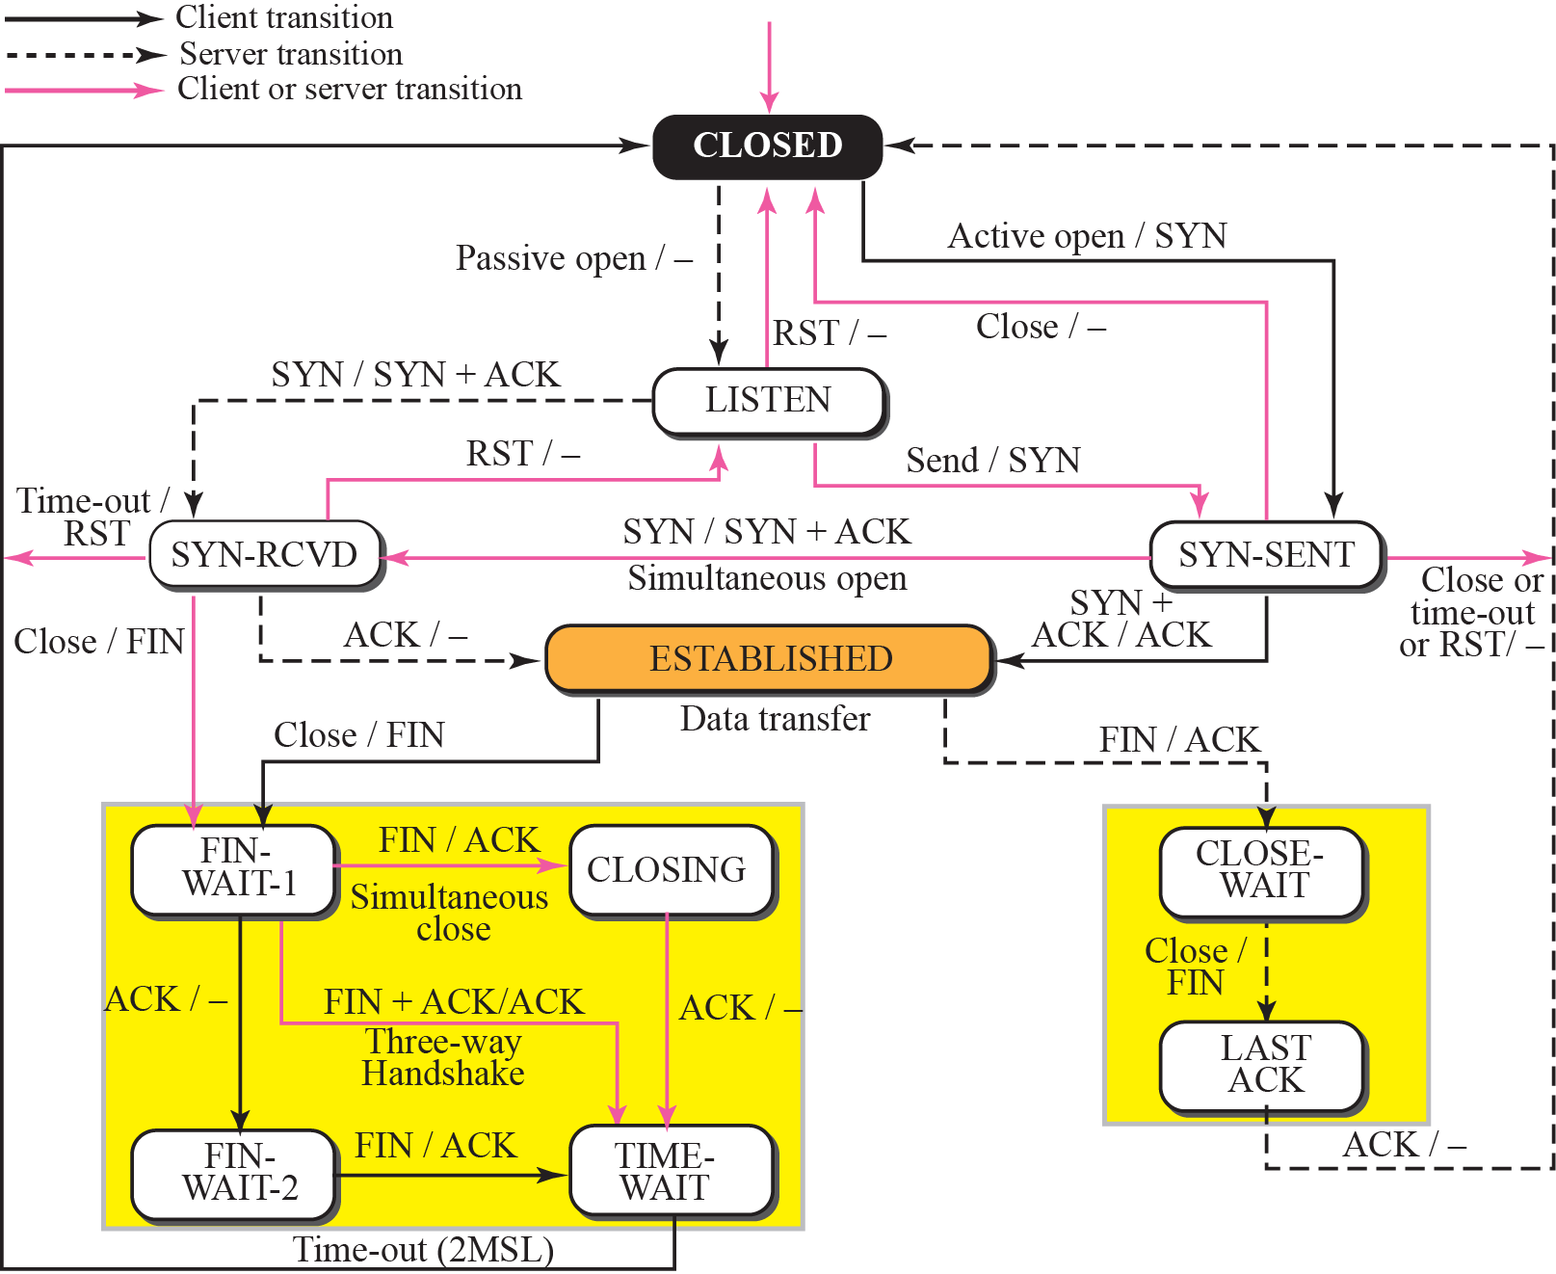
Figure 15.13 State transition diagram

Slide 28
Note
The state marked as ESTBLISHED in the FSM is in fact two different
sets of states that the client and server undergo to transfer data.

Slide 30
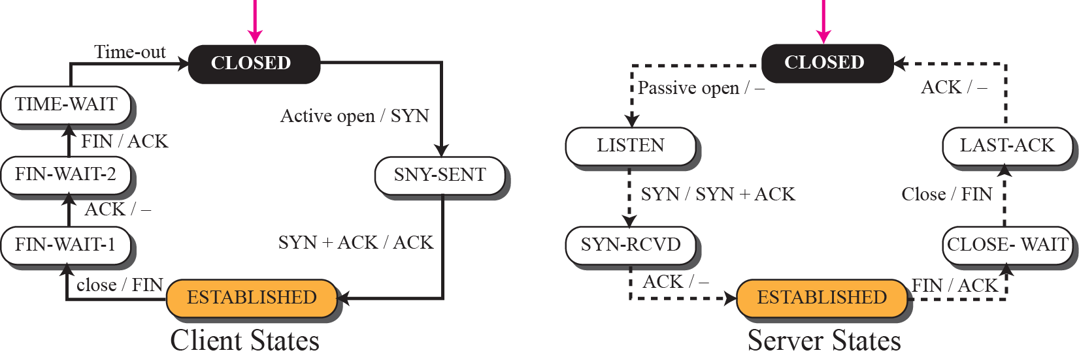
Figure 15.14 Transition diagram for connection and half-close termination

Slide 31
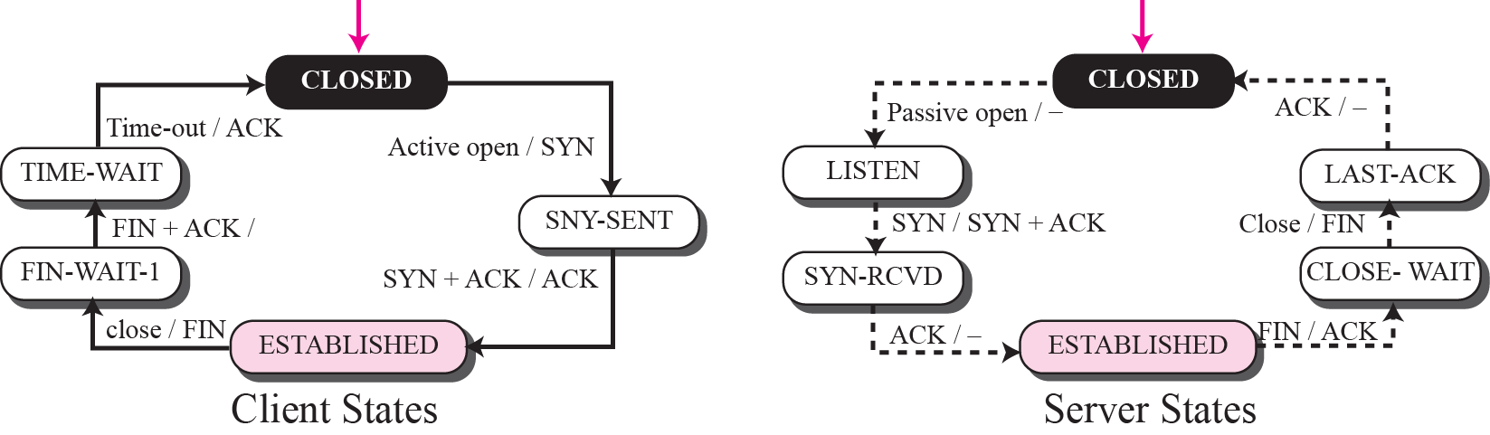
Figure 15.15 Transition diagram for a common scenario

Slide 32
15-6 WINDOWS IN TCP
Before discussing data transfer in TCP and the issues such as flow, error, and congestion control, we describe the windows used in TCP. TCP uses two windows (send window and receive window) for each direction of data transfer, which means four windows for a bidirectional communication. To make the discussion simple, we make an assumption that communication is only unidirectional; the bidirectional communication can be inferred using two unidirectional communications with piggybacking.

Slide 33
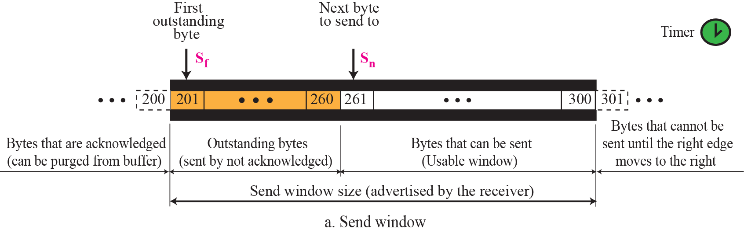
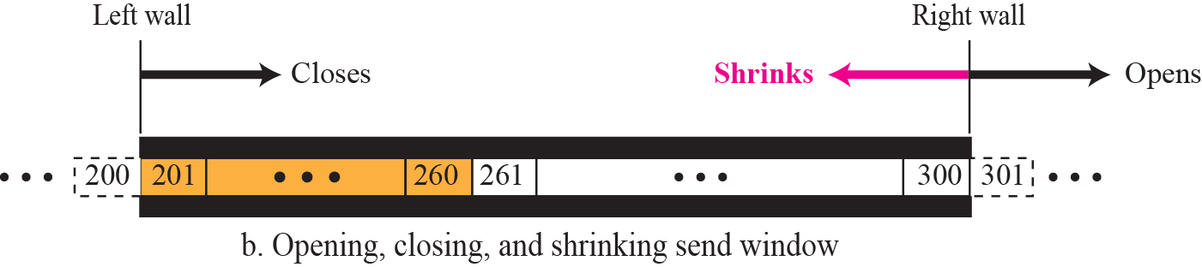
Figure 15.16 Send window in TCP

Slide 34
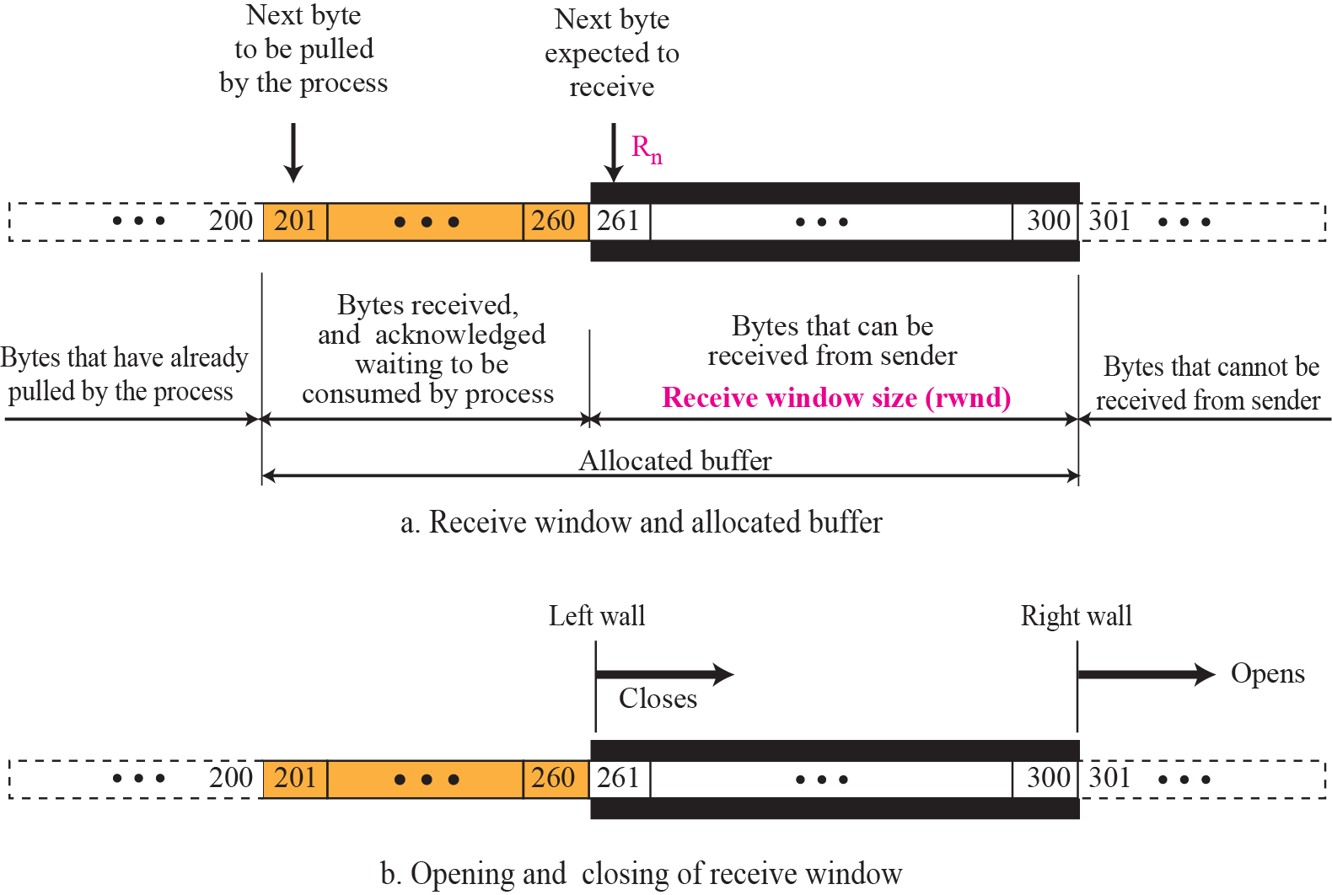
Figure 15.17 Receive window in TCP

Slide 35
15-7 FLOW CONTROL
As discussed in Chapter 13, flow control balances the rate a producer creates data with the rate a consumer can use the data. TCP separates flow control from error control. In this section we discuss flow control, ignoring error control. We temporarily assume that the logical channel between the sending and receiving TCP is error-free. Figure 15.24 shows unidirectional data transfer between a sender and a receiver; bidirectional data transfer can be deduced from unidirectional one as discussed in Chapter 13.

Slide 36
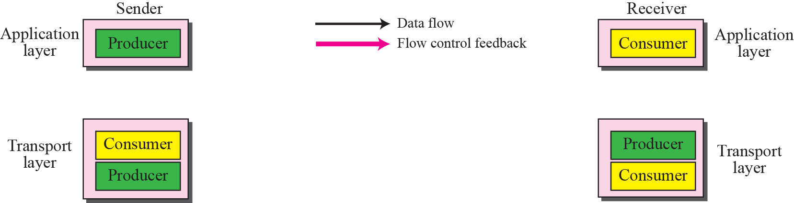
Figure 15.18 TCP/IP protocol suite

Slide 37
Silly Window Syndrome (1)
Sending data in very small segments
Syndrome created by the Sender
Sending application program creates data slowly (e.g. 1 byte at a time)
Wait and collect data to send in a larger block
How long should the sending TCP wait?
Solution: Nagle’s algorithm
Nagle’s algorithm takes into account (1) the speed of the application program that creates the data, and (2) the speed of the network that transports the data

Slide 38
Silly Window Syndrome (2)
Syndrome created by the Receiver
Receiving application program consumes data slowly (e.g. 1 byte at a time)
The receiving TCP announces a window size of 1 byte. The sending TCP sends only 1 byte…
Solution 1: Clark’s solution
Sending an ACK but announcing a window size of zero until there is enough space to accommodate a segment of max. size or until half of the buffer is empty

Slide 39
Silly Window Syndrome (3)
Solution 2: Delayed Acknowledgement
The receiver waits until there is decent amount of space in its incoming buffer before acknowledging the arrived segments
The delayed acknowledgement prevents the sending TCP from sliding its window. It also reduces traffic.
Disadvantage: it may force the sender to retransmit the unacknowledged segments
To balance: should not be delayed by more than 500ms

Slide 40
15-8 ERROR CONTROL
TCP is a reliable transport layer protocol. This means that an application program that delivers a stream of data to TCP relies on TCP to deliver the entire stream to the application program on the other end in order, without error, and without any part lost or duplicated.
Error control in TCP is achieved through the use of three tools: checksum, acknowledgment, and time-out.

Slide 41
Topics Discussed in the Section
Checksum
Acknowledgment
Retransmission
Out-of-Order Segments
FSMs for Data Transfer in TCP
Some Scenarios

Slide 42
Note
ACK segments do not consume sequence numbers and
are not acknowledged.

Slide 43
Acknowledgement Type
In the past, TCP used only one type of acknowledgement: Accumulative Acknowledgement (ACK), also namely accumulative positive acknowledgement
More and more implementations are adding another type of acknowledgement: Selective Acknowledgement (SACK), SACK is implemented as an option at the end of the TCP header.

Slide 44
Note
Data may arrive out of order and be temporarily stored by the receiving TCP,
but TCP guarantees that no out-of-order data are delivered to the process.

Slide 45
Note
TCP can be best modeled as a Selective Repeat protocol.

Slide 46
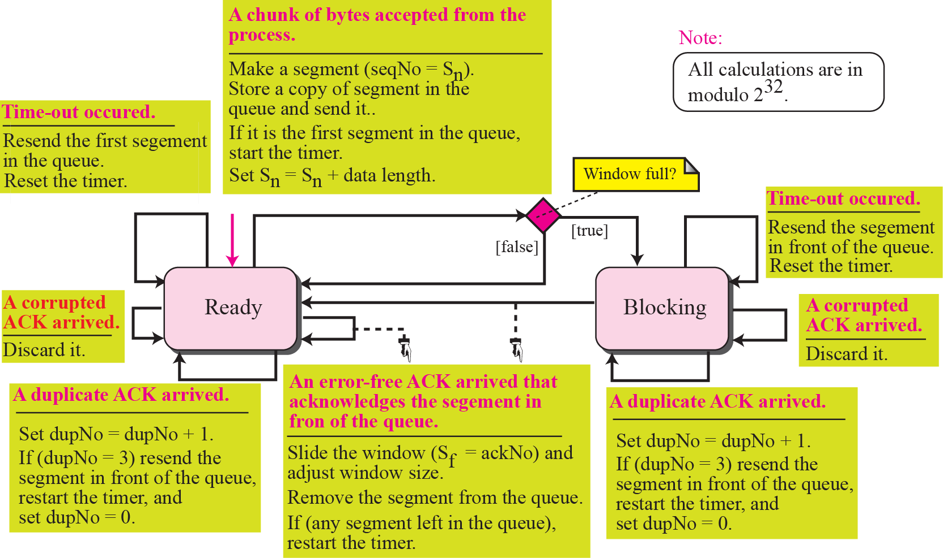
Figure 15.19 Simplified FSM for sender site

Slide 47
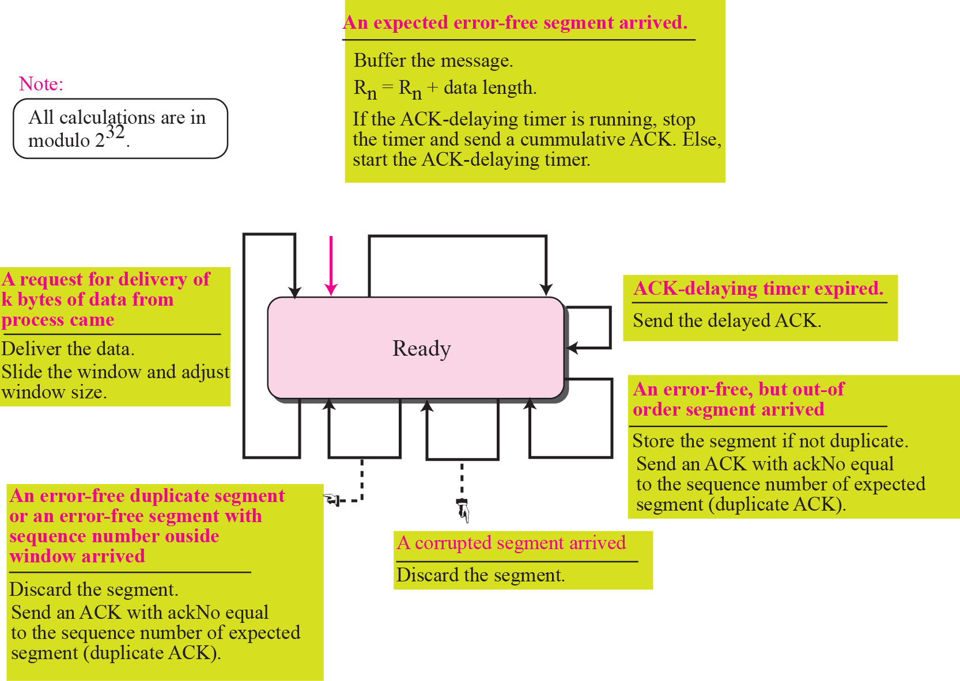
Figure 15.20 Simplified FSM for the receiver site

Slide 48
Rules for Generating ACK (1)
1. When one end sends a data segment to the other end, it must include an ACK. That gives the next sequence number it expects to receive. (Piggyback)
2. The receiver needs to delay sending (until another segment arrives or 500ms) an ACK segment if there is only one outstanding in-order segment. It prevents ACK segments from creating extra traffic.
3. There should not be more than 2 in-order unacknowledged segments at any time. It prevent the unnecessary retransmission

Slide 49
Rules for Generating ACK (2)
4. When a segment arrives with an out-of-order sequence number that is higher than expected, the receiver immediately sends an ACK segment announcing the sequence number of the next expected segment. (for fast retransmission)
5. When a missing segment arrives, the receiver sends an ACK segment to announce the next sequence number expected.
6. If a duplicate segment arrives, the receiver immediately sends an ACK.

Slide 50
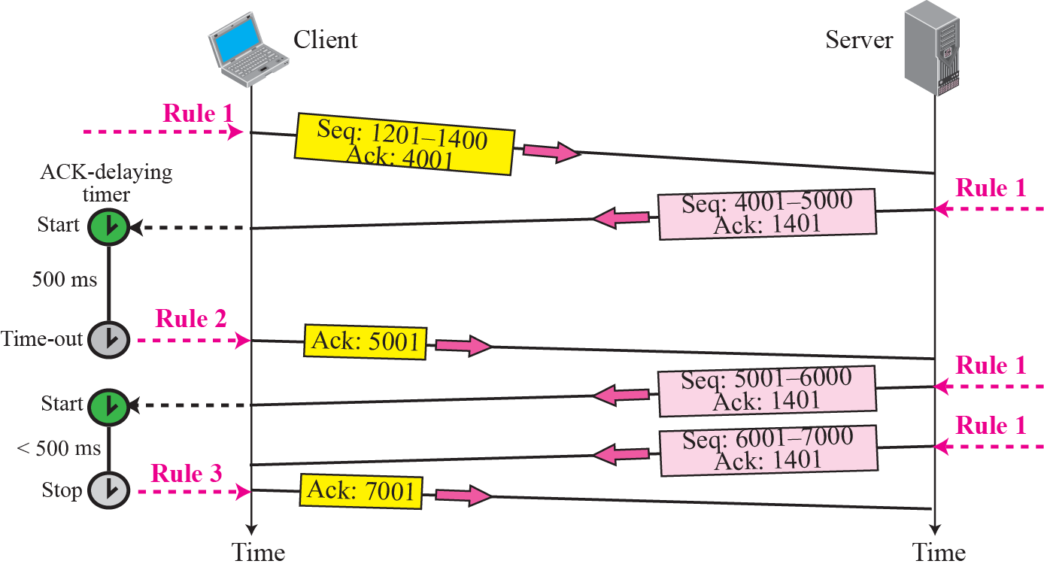
Figure 15.21 Normal operation

Slide 51
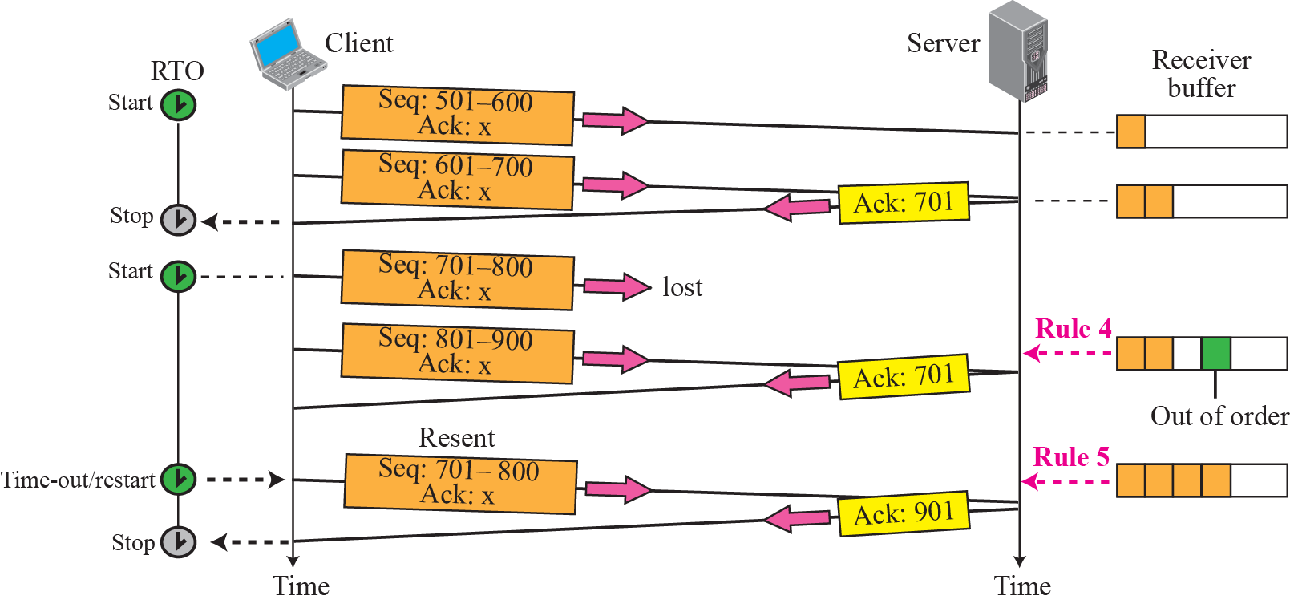
Figure 15.22 Lost segment

Slide 52
Note
The receiver TCP delivers only ordered data to the process.

Slide 53
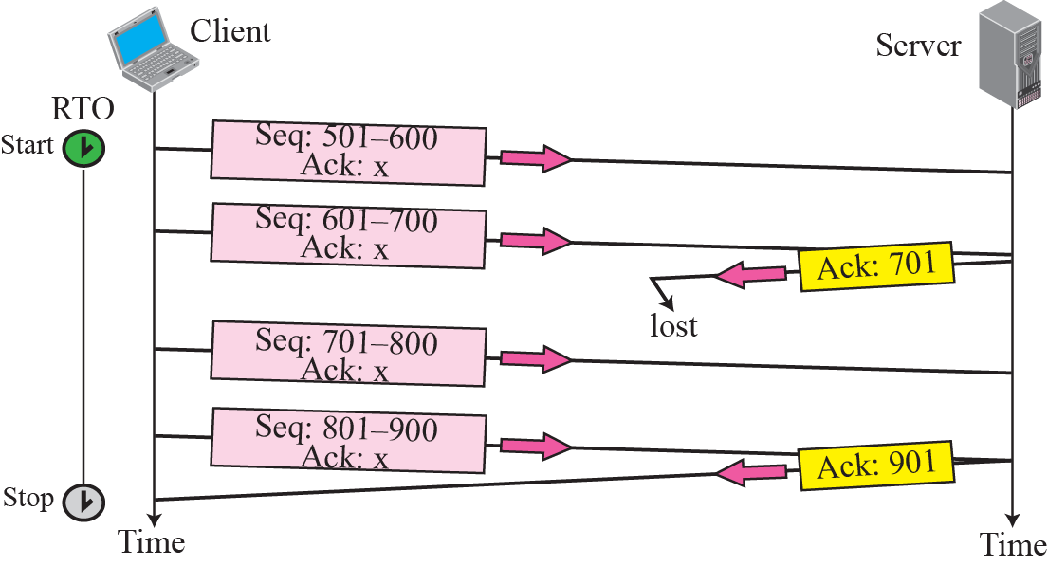
Figure 15.23 Lost acknowledgment

Slide 54
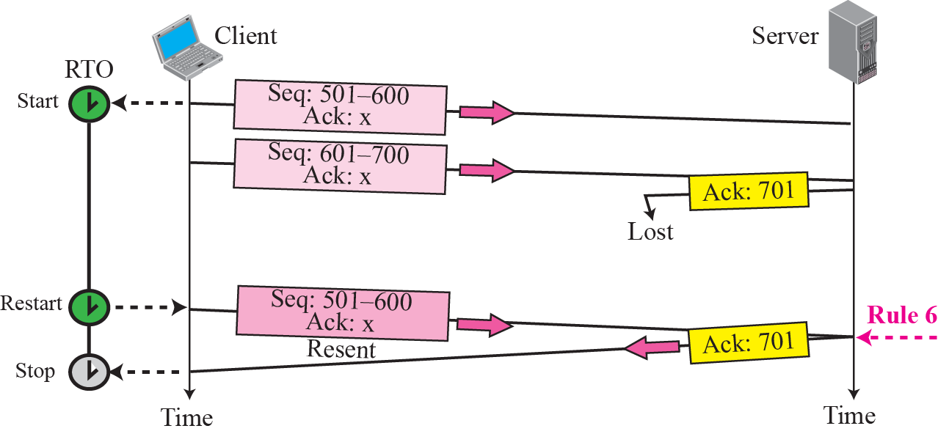
Figure 15.24 Lost acknowledgment corrected by resending a segment

Slide 55
Note
Lost acknowledgments may create deadlock if they are not
properly handled.

Slide 56
15-9 CONGESTION CONTROL
We discussed congestion control in Chapter 13. Congestion control in TCP is based on both open loop and closed-loop mechanisms. TCP uses a congestion window and a congestion policy that avoid congestion and detect and alleviate congestion after it has occurred.

Slide 57
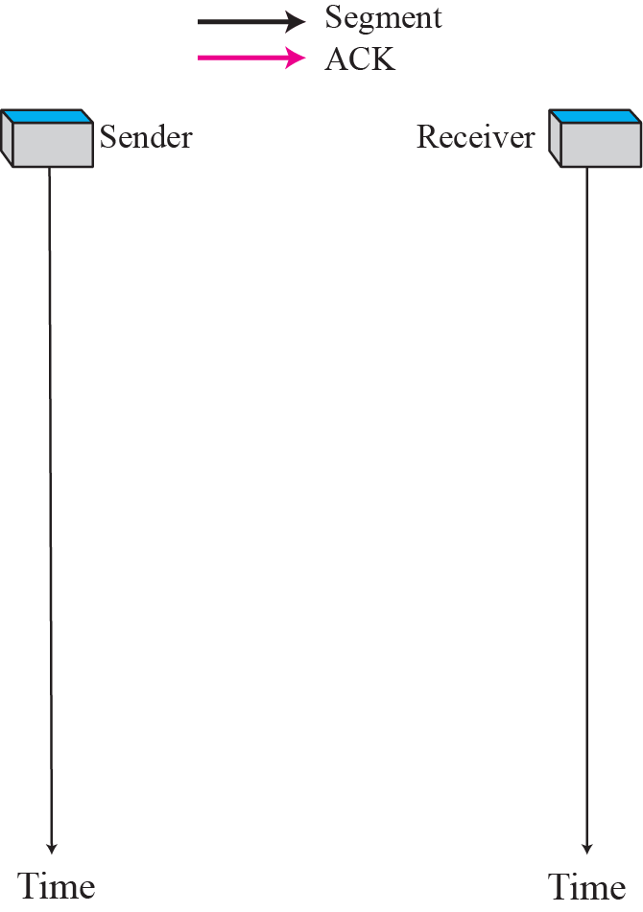
Figure 15.25 Slow start, exponential increase

Slide 58
Note
In the slow start algorithm, the size of the congestion window increases exponentially until it reaches a threshold.

Slide 59
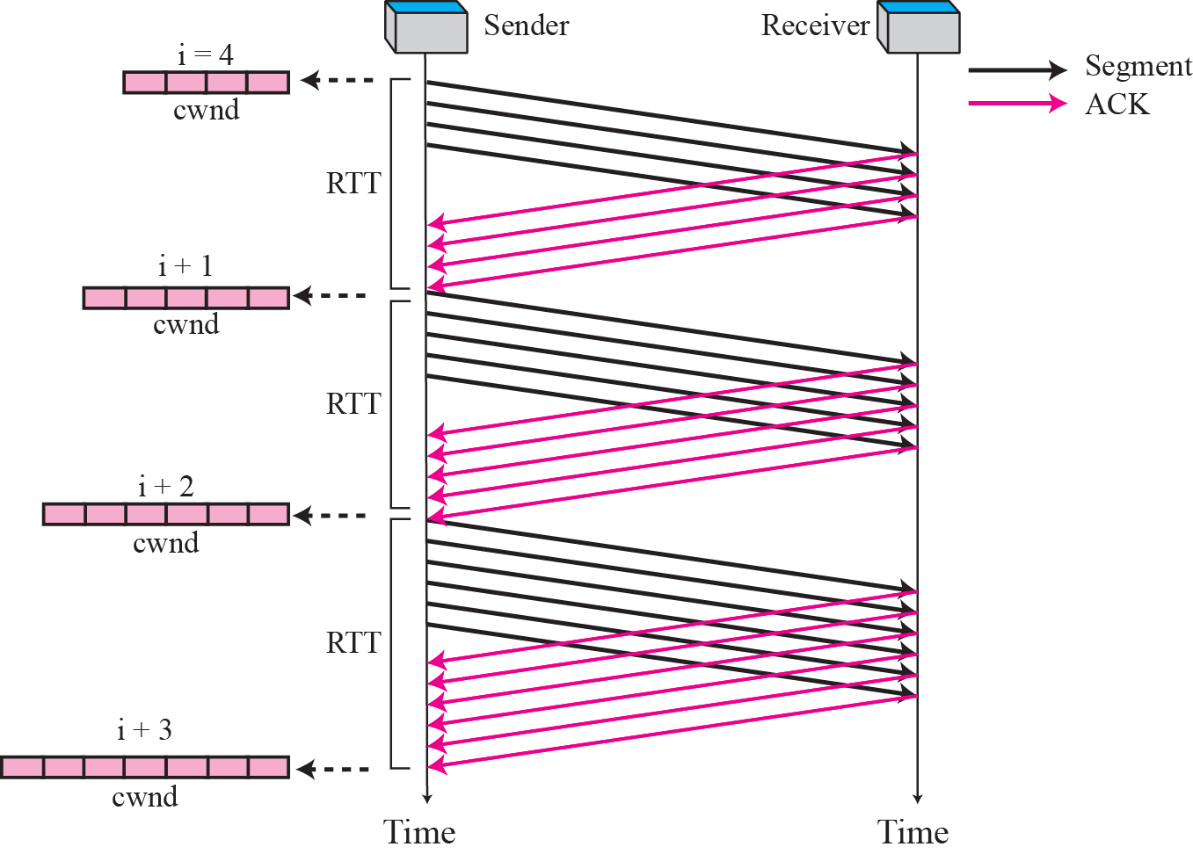
Figure 15.26 Congestion avoidance, additive increase

Slide 60
Note
In the congestion avoidance algorithm the size of the congestion window
increases additively until
congestion is detected.

Slide 61
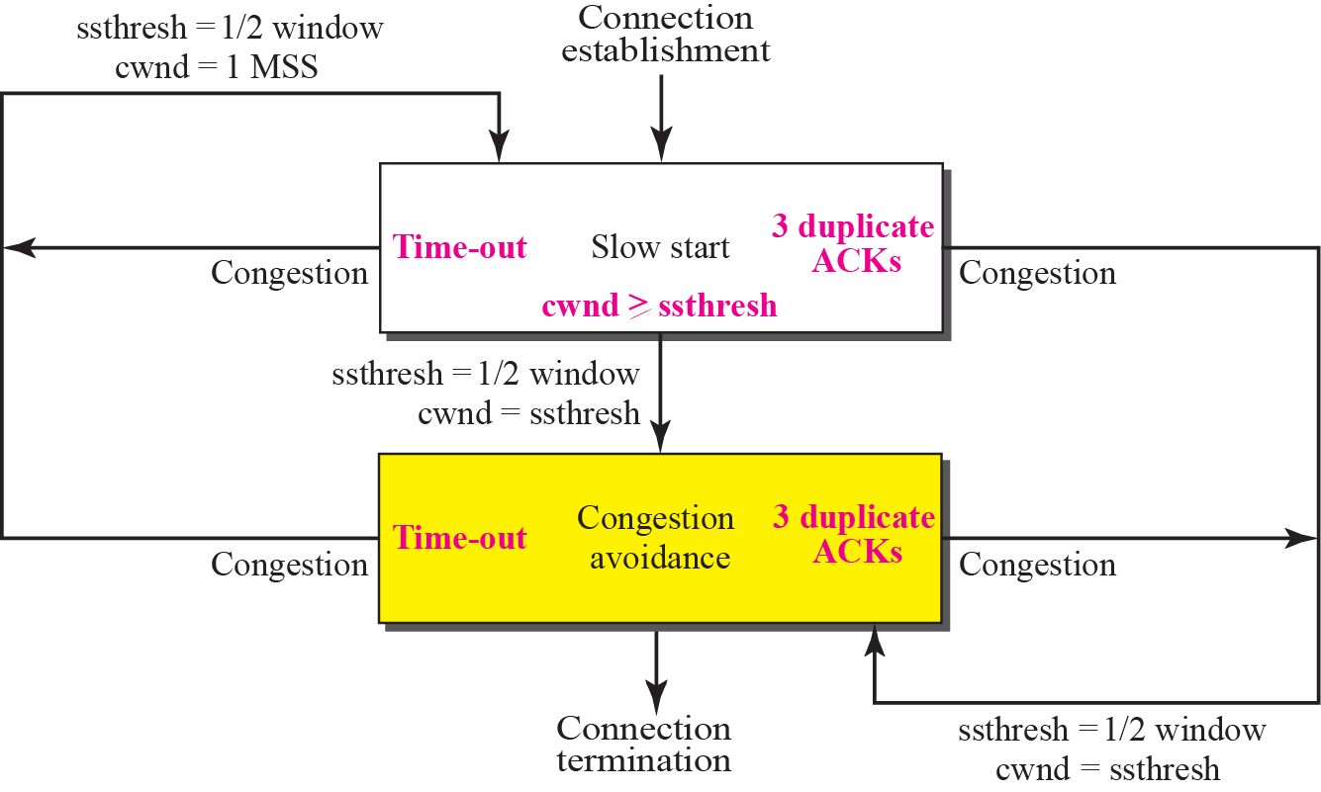
Figure 15.27 TCP Congestion policy summary

Slide 62
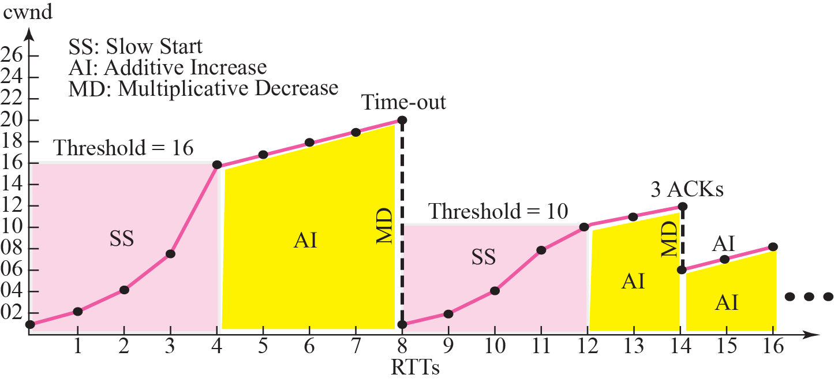
Figure 15.28 Congestion example

